Slide 1
MODULE -4
BAYSEIAN LEARNING

Slide 2
CONTENT
Introduction
Bayes theorem
Bayes theorem and concept learning
Maximum likelihood and Least Squared Error Hypothesis
Maximum likelihood Hypotheses for predicting probabilities
Minimum Description Length Principle
Naive Bayes classifier
Bayesian belief networks
EM algorithm

Slide 3
INTRODUCTION
Bayesian learning methods are relevant to study of machine learning for two different reasons.
First, Bayesian learning algorithms that calculate explicit probabilities for hypotheses, such as the naive Bayes classifier, are among the most practical approaches to certain types of learning problems
The second reason is that they provide a useful perspective for understanding many learning algorithms that do not explicitly manipulate probabilities.

Slide 4
Features of Bayesian Learning Methods
Each observed training example can incrementally decrease or increase the estimated probability that a hypothesis is correct. This provides a more flexible approach to learning than algorithms that completely eliminate a hypothesis if it is found to be inconsistent with any single example
Prior knowledge can be combined with observed data to determine the final probability of a hypothesis. In Bayesian learning, prior knowledge is provided by asserting (1) a prior probability for each candidate hypothesis, and (2) a probability distribution over observed data for each possible hypothesis.
Bayesian methods can accommodate hypotheses that make probabilistic predictions
New instances can be classified by combining the predictions of multiple hypotheses, weighted by their probabilities.
Even in cases where Bayesian methods prove computationally intractable, they can provide a standard of optimal decision making against which other practical methods can be measured.

Slide 5
Practical difficulty in applying Bayesian methods
One practical difficulty in applying Bayesian methods is that they typically require initial knowledge of many probabilities. When these probabilities are not known in advance they are often estimated based on background knowledge, previously available data, and assumptions about the form of the underlying distributions.
A second practical difficulty is the significant computational cost required to determine the Bayes optimal hypothesis in the general case. In certain specialized situations, this computational cost can be significantly reduced.

Slide 6
BAYES THEOREM
Bayes theorem provides a way to calculate the probability of a hypothesis based on its prior probability, the probabilities of observing various data given the hypothesis, and the observed data itself.
Notations
P(h) prior probability of h, reflects any background knowledge about the chance that h is correct
P(D) prior probability of D, probability that D will be observed
P(D|h) probability of observing D given a world in which h holds
P(h|D) posterior probability of h, reflects confidence that h holds after D has been observed

Slide 7
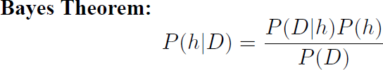
Bayes theorem is the cornerstone of Bayesian learning methods because it provides a way to calculate the posterior probability P(h|D), from the prior probability P(h), together with P(D) and P(D(h).
P(h|D) increases with P(h) and with P(D|h) according to Bayes theorem.
P(h|D) decreases as P(D) increases, because the more probable it is that D will be
observed independent of h, the less evidence D provides in support of h.

Slide 8
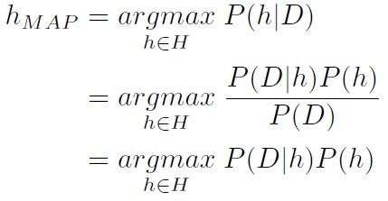
Maximum a Posteriori (MAP) Hypothesis
In many learning scenarios, the learner considers some set of candidate hypotheses H and is interested in finding the most probable hypothesis h ∈ H given the observed data D. Any such maximally probable hypothesis is called a maximum a posteriori (MAP) hypothesis.
Bayes theorem to calculate the posterior probability of each candidate hypothesis is h_{MAP}
is a MAP hypothesis provided
P(D) can be dropped, because it is a constant independent of h

Slide 9
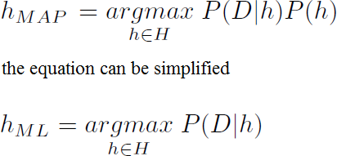
Maximum Likelihood (ML) Hypothesis
In some cases, it is assumed that every hypothesis in H is equally probable a priori
(P(h_{i}) = P(h_{j}) for all h_{i} and h_{j} in H).
In this case the below equation can be simplified and need only consider the term
P(D|h) to find the most probable hypothesis.
P(D|h) is often called the likelihood of the data D given h, and any hypothesis that
maximizes P(D|h) is called a maximum likelihood (ML) hypothesis

Slide 10
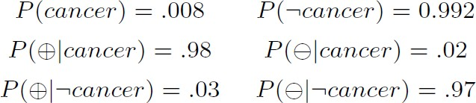
Example
Consider a medical diagnosis problem in which there are two alternative hypotheses
The patient has a particular form of cancer (denoted by cancer)
The patient does not (denoted by ¬ cancer)
The available data is from a particular laboratory with two possible outcomes: + (positive) and - (negative)

Slide 11
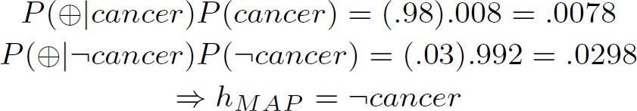
Suppose a new patient is observed for whom the lab test returns a positive (+) result.
Should we diagnose the patient as having cancer or not?

Slide 12
BAYES THEOREM AND CONCEPT LEARNING
What is the relationship between Bayes theorem and the problem of concept learning?
Since Bayes theorem provides a principled way to calculate the posterior probability of each hypothesis given the training data, and can use it as the basis for a straightforward learning algorithm that calculates the probability for each possible hypothesis, then outputs the most probable.

Slide 13
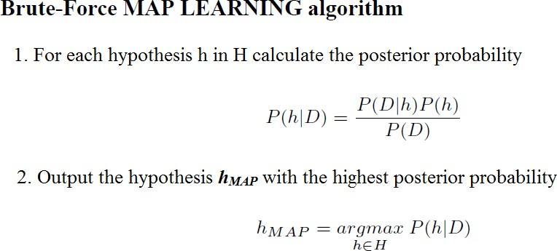
Brute-Force Bayes Concept Learning
We can design a straightforward concept learning algorithm to output the maximum
a posteriori hypothesis, based on Bayes theorem, as follows:

Slide 14
In order specify a learning problem for the BRUTE-FORCE MAP LEARNING
algorithm we must specify what values are to be used for P(h) and for P(D|h) ?
Lets choose P(h) and for P(D|h) to be consistent with the following assumptions:
The training data D is noise free (i.e., d_{i} = c(x_{i}))
The target concept c is contained in the hypothesis space H
We have no a priori reason to believe that any hypothesis is more probable than any other.

Slide 15
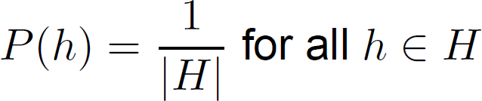
What values should we specify for P(h)?
Given no prior knowledge that one hypothesis is more likely than another, it is reasonable to assign the same prior probability to every hypothesis h in H.
Assume the target concept is contained in H and require that these prior probabilities sum to 1.

Slide 16
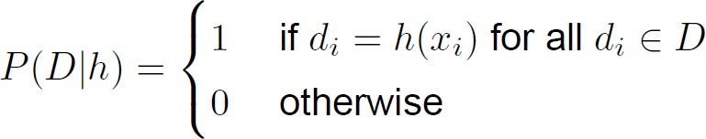
What choice shall we make for P(D|h)?
P(D|h) is the probability of observing the target values D = (d₁ . . .d_{m}) for the fixed set of instances (x₁ . . . x_{m}), given a world in which hypothesis h holds
Since we assume noise-free training data, the probability of observing
classification d_{i} given h is just 1 if d_{i} = h(x_{i}) and 0 if d_{i} # h(x_{i}). Therefore,

Slide 17
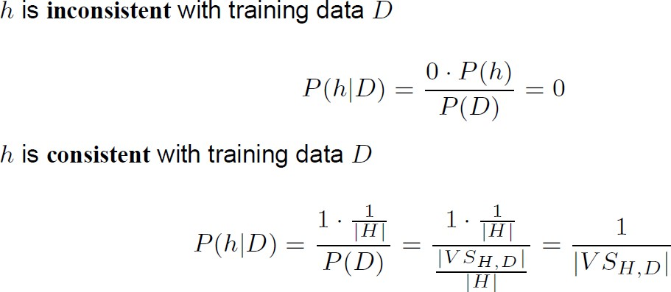
Given these choices for P(h) and for P(D|h) we now have a fully-defined problem for the above BRUTE-FORCE MAP LEARNING algorithm.
In a first step, we have to determine the probabilities for P(h|D)

Slide 18
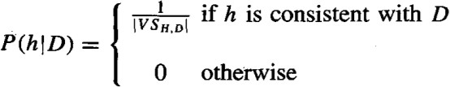
To summarize, Bayes theorem implies that the posterior probability P(h|D) under our assumed P(h) and P(D|h) is
where |VS_{H,D}| is the number of hypotheses from H consistent with D

Slide 19
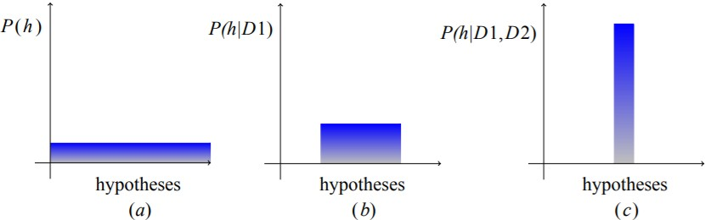
The Evolution of Probabilities Associated with Hypotheses
Figure (a) all hypotheses have the same probability.
Figures (b) and (c), As training data accumulates, the posterior probability for inconsistent hypotheses becomes zero while the total probability summing to 1 is shared equally among the remaining consistent hypotheses.

Slide 20
MAP Hypotheses and Consistent Learners
A learning algorithm is a consistent learner if it outputs a hypothesis that commits zero errors over the training examples.
Every consistent learner outputs a MAP hypothesis, if we assume a uniform prior probability distribution over H (P(h_{i}) = P(h_{j}) for all i, j), and deterministic, noise free training data (P(D|h) =1 if D and h are consistent, and 0 otherwise).
Example:
FIND-S outputs a consistent hypothesis, it will output a MAP hypothesis under the probability distributions P(h) and P(D|h) defined above.
Are there other probability distributions for P(h) and P(D|h) under which FIND-S outputs MAP
hypotheses? Yes.
Because FIND-S outputs a maximally specific hypothesis from the version space, its output hypothesis will be a MAP hypothesis relative to any prior probability distribution that favours more specific hypotheses.

Slide 21
Bayesian framework is a way to characterize the behaviour of learning algorithms
By identifying probability distributions P(h) and P(D|h) under which the output is a optimal hypothesis, implicit assumptions of the algorithm can be characterized (Inductive Bias)
Inductive inference is modelled by an equivalent probabilistic reasoning system based on Bayes theorem

Slide 22
MAXIMUM LIKELIHOOD AND LEAST-SQUARED ERROR HYPOTHESES
Consider the problem of learning a continuous-valued target function such as neural network learning, linear regression, and polynomial curve fitting
A straightforward Bayesian analysis will show that under certain assumptions any learning algorithm that minimizes the squared error between the output hypothesis predictions and the training data will output a maximum likelihood (ML) hypothesis

Slide 23
Learning A Continuous-Valued Target Function
Learner L considers an instance space X and a hypothesis space H consisting of some class of real- valued functions defined over X, i.e., (∀ h ∈ H)[ h : X → R] and training examples of the form
<x_{i},d_{i}>
The problem faced by L is to learn an unknown target function f : X → R
A set of m training examples is provided, where the target value of each example is corrupted by
random noise drawn according to a Normal probability distribution with zero mean (d_{i} = f(x_{i}) + e_{i})
Each training example is a pair of the form (x_{i} ,d_{i} ) where di = f (x_{i} ) + e_{i} .
Here f(x_{i}) is the noise-free value of the target function and e_{i} is a random variable representing
the noise.
It is assumed that the values of the e_{i} are drawn independently and that they are distributed according to a Normal distribution with zero mean.
The task of the learner is to output a maximum likelihood hypothesis, or, equivalently, a MAP
hypothesis assuming all hypotheses are equally probable a priori.

Slide 24
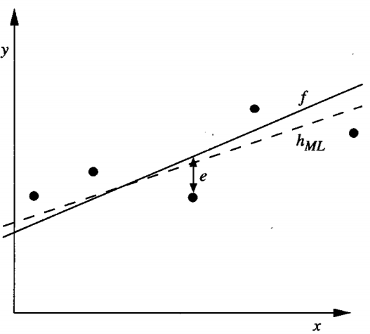
Learning A Linear Function
The target function f corresponds to the solid line.
The training examples (xi , di ) are assumed to have Normally distributed noise ei with zero mean added to the true target value f (xi ).
The dashed line corresponds to the hypothesis h_{ML} with least-squared training error, hence the maximum likelihood hypothesis.
Notice that the maximum likelihood hypothesis is not necessarily identical to the correct hypothesis, f, because it is inferred from only a limited sample of noisy training data

Slide 25

Before showing why a hypothesis that minimizes the sum of squared errors in this setting is also a maximum likelihood hypothesis, let us quickly review probability densities and Normal distributions
Probability Density for continuous variables
e: a random noise variable generated by a Normal probability distribution
<x₁ . . . x_{m}>: the sequence of instances (as before)
<d₁ . . . d_{m}>: the sequence of target values with di = f(x_{i}) + e_{i}

Slide 26

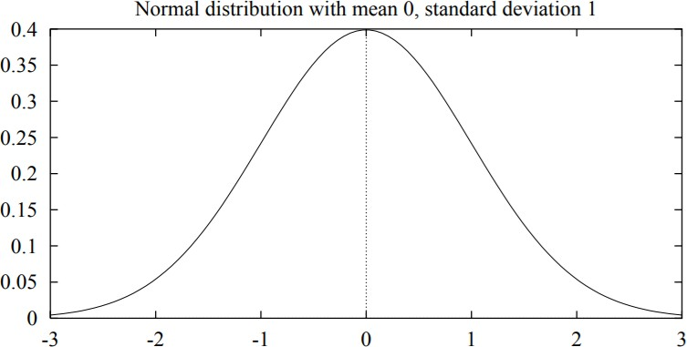
Normal Probability Distribution (Gaussian Distribution)
A Normal distribution is a smooth, bell-shaped distribution that can be completely characterized by its mean μ and its standard deviation σ

Slide 27
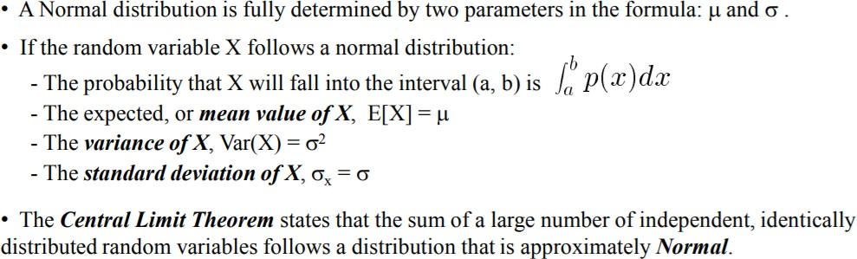

Slide 28



Using the previous definition of h_{ML} we have
Assuming training examples are mutually independent given h, we can write P(D|h) as the product of the various (d_{i}|h)
Given the noise e_{i} obeys a Normal distribution with zero mean and unknown variance σ² , each d_{i} must also obey a Normal distribution around the true targetvalue f(x_{i}). Because we are writing the expression for P(D|h), we assume h is the correct description of f. Hence, µ = f(x_{i}) = h(x_{i})

Slide 29
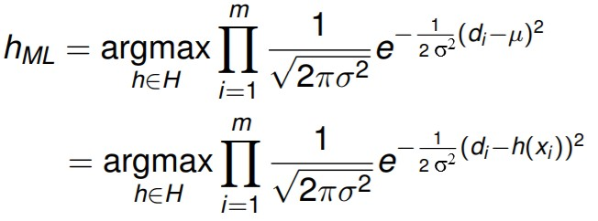
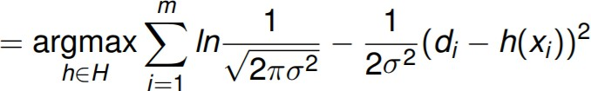
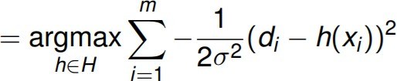
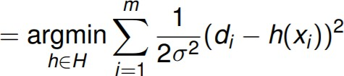
It is common to maximize the less complicated logarithm, which is justified because of the monotonicity of function p.
The first term in this expression is a constant independent of h and can therefore be discarded
Maximizing this negative term is equivalent to minimizing the corresponding positive term.

Slide 30

Finally Discard constants that are independent of h
the h_{ML} is one that minimizes the sum of the squared errors
Why is it reasonable to choose the Normal distribution to characterize noise?
good approximation of many types of noise in physical systems
Central Limit Theorem shows that the sum of a sufficiently large number of independent, identically distributed random variables itself obeys a Normal distribution
Only noise in the target value is considered, not in the attributes describing the instances
themselves

Slide 31
MAXIMUM LIKELIHOOD HYPOTHESES FOR PREDICTING PROBABILITIES
Consider the setting in which we wish to learn a nondeterministic (probabilistic) function f : X → {0, 1}, which has two discrete output values.
We want a function approximator whose output is the probability that f(x) = 1 In other words , learn the target function
f’ : X → [0, 1] such that f’ (x) = P(f(x) = 1)
How can we learn f' using a neural network?
Use of brute force way would be to first collect the observed frequencies of 1's and 0's for each possible value of x and to then train the neural network to output the target frequency for each x.

Slide 32


What criterion should we optimize in order to find a maximum likelihood hypothesis for f' in this setting?
First obtain an expression for P(D|h)
Assume the training data D is of the form D = {(x₁, d₁) . . . (x_{m}, d_{m})}, where d_{i} is the observed 0 or 1 value for f (x_{i}).
Both x_{i} and d_{i} as random variables, and assuming that each training example is drawn independently, we can write P(D|h) as
Applying the product rule

Slide 33
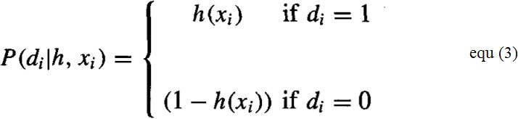

The probability P(d_{i}|h, x_{i})
Re-express it in a more mathematically manipulable form, as
Equation (4) to substitute for P(d_{i} |h, x_{i}) in Equation (5) to obtain

Slide 34



We write an expression for the maximum likelihood hypothesis
The last term is a constant independent of h, so it can be dropped
It easier to work with the log of the likelihood, yielding
Equation (7) describes the quantity that must be maximized in order to obtain the maximum likelihood hypothesis in our current problem setting

Slide 35
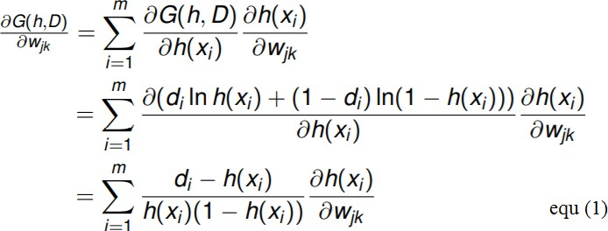
Gradient Search to Maximize Likelihood in a Neural Net
Derive a weight-training rule for neural network learning that seeks to maximize G(h, D) using
gradient ascent
The gradient of G(h, D) is given by the vector of partial derivatives of G(h, D) with respect to the various network weights that define the hypothesis h represented by the learned network
In this case, the partial derivative of G(h, D) with respect to weight w_{jk} from input k to unit j is

Slide 36

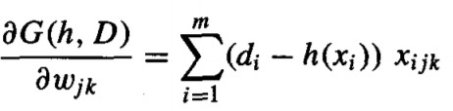
Suppose our neural network is constructed from a single layer of sigmoid units. Then,
where x_{ijk} is the k^{th} input to unit j for the i^{th} training example, and d(x) is the derivative of the sigmoid squashing function.
Finally, substituting this expression into Equation (1), we obtain a simple expression for the
derivatives that constitute the gradient

Slide 37
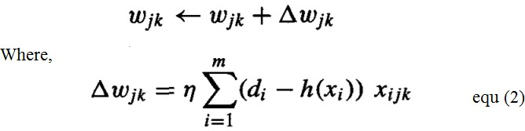
Because we seek to maximize rather than minimize P(D|h), we perform gradient ascent rather than gradient descent search. On each iteration of the search the weight vector is adjusted in the direction of the gradient, using the weight update rule
where η is a small positive constant that determines the step size of the i gradient ascent search

Slide 38
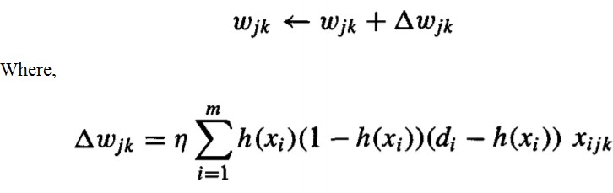
It is interesting to compare this weight-update rule to the weight-update rule used by the BACKPROPAGATION algorithm to minimize the sum of squared errors between predicted and observed network outputs.
The BACKPROPAGATION update rule for output unit weights, re-expressed using our current
notation, is

Slide 39

MINIMUM DESCRIPTION LENGTH PRINCIPLE
A Bayesian perspective on Occam’s razor
Motivated by interpreting the definition of h_{MAP} in the light of basic concepts from information theory.
which can be equivalently expressed in terms of maximizing the log₂
or alternatively, minimizing the negative of this quantity
This equation can be interpreted as a statement that short hypotheses are preferred, assuming a particular representation scheme for encoding hypotheses and data

Slide 40
Introduction to a basic result of information theory
Consider the problem of designing a code to transmit messages drawn at random
i is the message
The probability of encountering message i is p_{i}
Interested in the most compact code; that is, interested in the code that minimizes the
expected number of bits we must transmit in order to encode a message drawn at random
To minimize the expected code length we should assign shorter codes to messages that are more probable
Shannon and Weaver (1949) showed that the optimal code (i.e., the code that minimizes the expected message length) assigns - log, pi bits to encode message i.
The number of bits required to encode message i using code C as the description length
of message i with respect to C, which we denote by L_{c}(i).

Slide 41
Interpreting the equation
-log₂P(h): the description length of h under the optimal encoding for the hypothesis space H L_{CH} (h) = −log₂P(h), where C_{H} is the optimal code for hypothesis space H.
-log₂P(D | h): the description length of the training data D given hypothesis h, under the optimal encoding fro the hypothesis space H: L_{CH} (D|h) = −log₂P(D| h) , where C _{D|h} is the optimal code for describing data D assuming that both the sender and receiver know the hypothesis h.
Rewrite Equation (1) to show that h_{MAP} is the hypothesis h that minimizes the sum given by the description length of the hypothesis plus the description length of the data given the hypothesis.
where C_{H} and C_{D|h} are the optimal encodings for H and for D given h

Slide 42

The Minimum Description Length (MDL) principle recommends choosing the hypothesis that minimizes the sum of these two description lengths of equ.
Minimum Description Length principle:
Where, codes C₁ and C₂ to represent the hypothesis and the data given the hypothesis
The above analysis shows that if we choose C₁ to be the optimal encoding of hypotheses C_{H}, and if we choose C₂ to be the optimal encoding C_{D|h}, then h_{MDL} = h_{MAP}

Slide 43
Application to Decision Tree Learning
Apply the MDL principle to the problem of learning decision trees from some training data.
What should we choose for the representations C₁ and C₂ of hypotheses and data?
For C₁: C₁ might be some obvious encoding, in which the description length grows with the number of nodes and with the number of edges
For C₂: Suppose that the sequence of instances (x₁ . . .x_{m}) is already known to both the transmitter
and receiver, so that we need only transmit the classifications (f (x₁) . . . f (x_{m})).
Now if the training classifications (f (x₁) . . .f(x_{m})) are identical to the predictions of the hypothesis, then there is no need to transmit any information about these examples. The description length of the classifications given the hypothesis ZERO
If examples are misclassified by h, then for each misclassification we need to transmit a message that identifies which example is misclassified as well as its correct classification
The hypothesis h_{MDL} under the encoding C₁ and C₂ is just the one that minimizes the sum of these
description lengths.

Slide 44
MDL principle provides a way for trading off hypothesis complexity for the number of errors committed by the hypothesis
MDL provides a way to deal with the issue of overfitting the data.
Short imperfect hypothesis may be selected over a long perfect hypothesis.

Slide 46
MOD 4

Slide 47
BAYESIAN BELIEF NETWORKS
The naive Bayes classifier makes significant use of the assumption that the values of the attributes a1 . . .an are conditionally independent given the target value v.
This assumption dramatically reduces the complexity of learning the target function
A Bayesian belief network describes the probability distribution governing a set of variables by specifying a set of conditional independence assumptions along with a set of conditional probabilities
Bayesian belief networks allow stating conditional independence assumptions that apply to subsets of the variables

Slide 48
Notation
Consider an arbitrary set of random variables Y1 . . . Yn , where each variable Yi can take on the set of possible values V(Yi).
The joint space of the set of variables Y to be the cross product V(Y1) x V(Y2) x. . . V(Yn).
In other words, each item in the joint space corresponds to one of the possible assignments of values to the tuple of variables (Y1 . . . Yn). The probability distribution over this joint' space is called the joint probability distribution.
The joint probability distribution specifies the probability for each of the possible variable bindings for the tuple (Y1 . . . Yn).
A Bayesian belief network describes the joint probability distribution for a set of variables.

Slide 49
Conditional Independence
Let X, Y, and Z be three discrete-valued random variables. X is conditionally independent of Y given Z if the probability distribution governing X is independent of the value of Y given a value for Z, that is, if

Slide 50

The above expression is written in abbreviated form as
P(X | Y, Z) = P(X | Z)
Conditional independence can be extended to sets of variables. The set of variables X1 . . . Xl is conditionally independent of the set of variables Y1 . . . Ym given the set of variables Z1 . . . Zn if
The naive Bayes classifier assumes that the instance attribute A1 is conditionally independent of instance attribute A2 given the target value V. This allows the naive Bayes classifier to calculate P(Al, A2 | V) as follows,

Slide 51
Representation
A Bayesian belief network represents the joint probability distribution for a set of variables. Bayesian networks (BN) are represented by directed acyclic graphs.

Slide 52
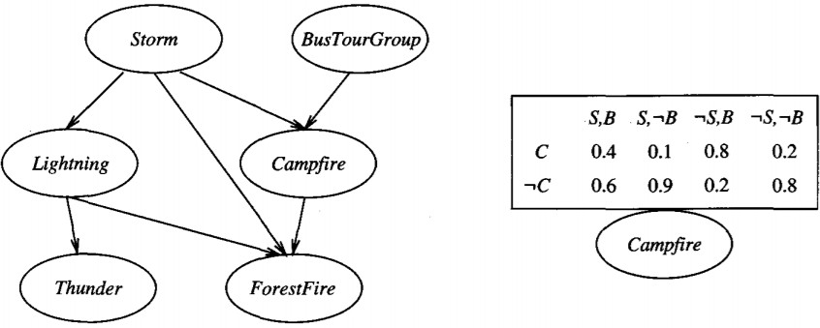

Slide 53
The Bayesian network in above figure represents the joint probability distribution over the boolean variables Storm, Lightning, Thunder, ForestFire, Campfire, and BusTourGroup
A Bayesian network (BN) represents the joint probability distribution by specifying a set of conditional independence assumptions
BN represented by a directed acyclic graph, together with sets of local conditional probabilities
Each variable in the joint space is represented by a node in the Bayesian network
The network arcs represent the assertion that the variable is conditionally independent of its non-descendants in the network given its immediate predecessors in the network.
A conditional probability table (CPT) is given for each variable, describing the probability distribution for that variable given the values of its immediate predecessors

Slide 54

The joint probability for any desired assignment of values (y1, . . . , yn) to the tuple of network variables (Y1 . . . Ym) can be computed by the formula
Where, Parents(Yi) denotes the set of immediate predecessors of yi in the network.
Example:
Consider the node Campfire. The network nodes and arcs represent the assertion that Campfire
is conditionally independent of its non-descendants Lightning and Thunder, given its immediate parents Storm and BusTourGroup.

Slide 56
This means that once we know the value of the variables Storm and BusTourGroup, the variables Lightning and Thunder provide no additional information about Campfire
The conditional probability table associated with the variable Campfire. The assertion is
P(Campfire = True | Storm = True, BusTourGroup = True) = 0.4
Inference
Use a Bayesian network to infer the value of some target variable (e.g., ForestFire) given the observed values of the other variables.
Inference can be straightforward if values for all of the other variables in the network are known exactly.
A Bayesian network can be used to compute the probability distribution for any subset of network variables given the values or distributions for any subset of the remaining variables.
An arbitrary Bayesian network is known to be NP-hard

Slide 57
Learning Bayesian Belief Networks
Effective algorithms can be considered for learning Bayesian belief networks from training data by considering several different settings for learning problem
First, the network structure might be given in advance, or it might have to be inferred from the training data.
Second, all the network variables might be directly observable in each training example, or some might be unobservable.
In the case where the network structure is given in advance and the variables are fully observable in the training examples, learning the conditional probability tables is straightforward and estimate the conditional probability table entries
In the case where the network structure is given but only some of the variable values are observable in the training data, the learning problem is more difficult. The learning problem can be compared to learning weights for an ANN.

Slide 58

Gradient Ascent Training of Bayesian Network
The gradient ascent rule which maximizes P(D|h) by following the gradient of ln P(D|h) with respect to the parameters that define the conditional probability tables of the Bayesian network.
Let wijk denote a single entry in one of the conditional probability tables. In particular wijk denote the conditional probability that the network variable Yi will take on the value yi, given that its immediate parents Ui take on the values given by uik.
The gradient of ln P(D|h) is given by the derivatives for each of the wijk. As shown below, each of these derivatives can be calculated as

Slide 59


Slide 60
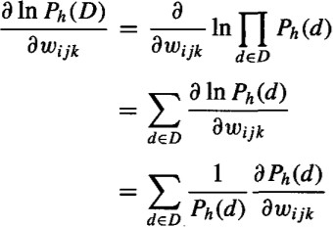
Derive the gradient defined by the set of derivativesfor all i, j, and k. Assuming the training examples d in the data set D are drawn independently, we write this derivative as

Slide 61
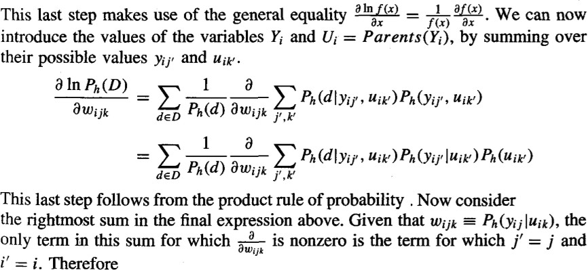
We write the abbreviation Ph(D) to represent P(D|h).

Slide 62
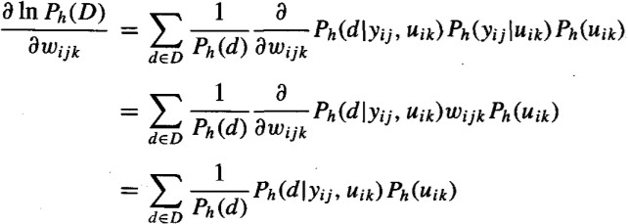

Slide 63
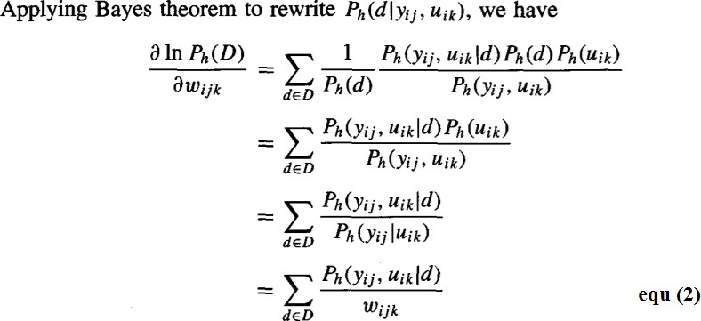

Slide 64
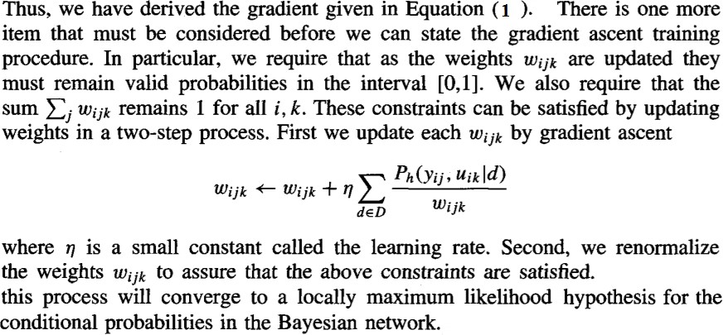

Slide 65
THE EM ALGORITHM
The EM algorithm can be used even for variables whose value is never directly observed, provided the general form of the probability distribution governing these variables is known.
Estimating Means of k Gaussians
Consider a problem in which the data D is a set of instances generated by a probability distribution that is a mixture of k distinct Normal distributions.

Slide 66
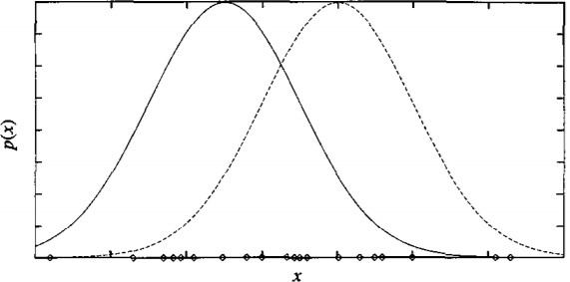

Slide 67
This problem setting is illustrated in Figure for the case where k = 2 and where the instances are the points shown along the x axis.
Each instance is generated using a two-step process.
First, one of the k Normal distributions is selected at random.
Second, a single random instance xi is generated according to this selected distribution.
This process is repeated to generate a set of data points as shown in the figure.

Slide 68
To simplify, consider the special case
The selection of the single Normal distribution at each step is based on choosing each with uniform probability
Each of the k Normal distributions has the same variance σ², known value.

Slide 69


The learning task is to output a hypothesis h = (μ1 , . . . ,μk) that describes the means of each of the k distributions.
We would like to find a maximum likelihood hypothesis for these means; that is, a hypothesis h that maximizes p(D |h).
In this case, the sum of squared errors is minimized by the sample mean
Our problem here, however, involves a mixture of k different Normal distributions, and we cannot observe which instances were generated by which distribution.
Consider full description of each instance as the triple (xi, zi1, zi2),
where xi is the observed value of the ith instance and
where zi1 and zi2 indicate which of the two Normal distributions was used to generate the value xi

Slide 70
In particular, zij has the value 1 if xi was created by the j^{th} Normal distribution and 0 otherwise.
Here xi is the observed variable in the description of the instance, and zil and zi2 are hidden variables.
If the values of zil and zi2 were observed, we could use following Equation to solve for the means p1 and p2
Because they are not, we will instead use the EM algorithm

Slide 71
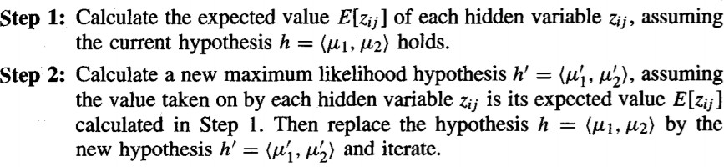
EM algorithm

Slide 72
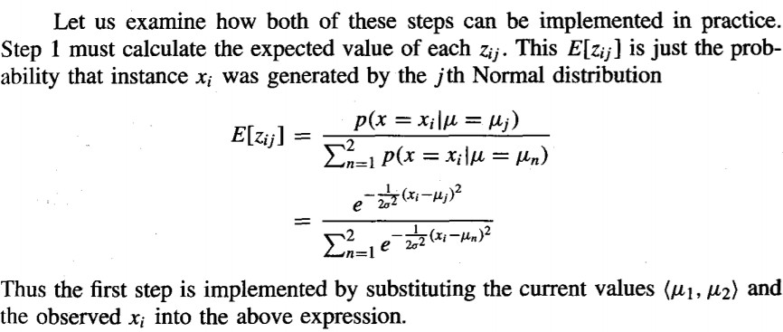

Slide 73
